Slide 1

Rohit Sahu

Slide 2
OBJECTIVE
To identify the Bug inside the code and to rectify it , so that it can be used for the making of application

Slide 3
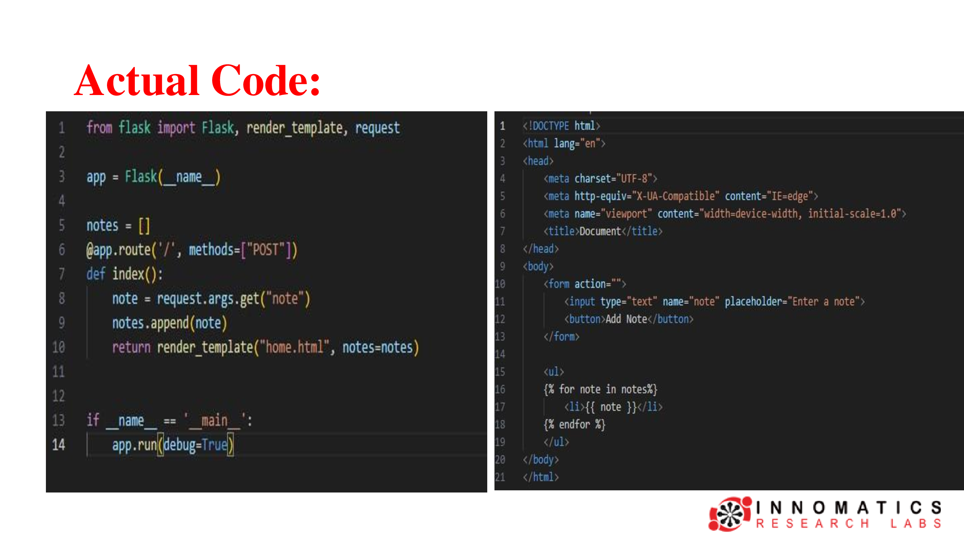

Slide 4
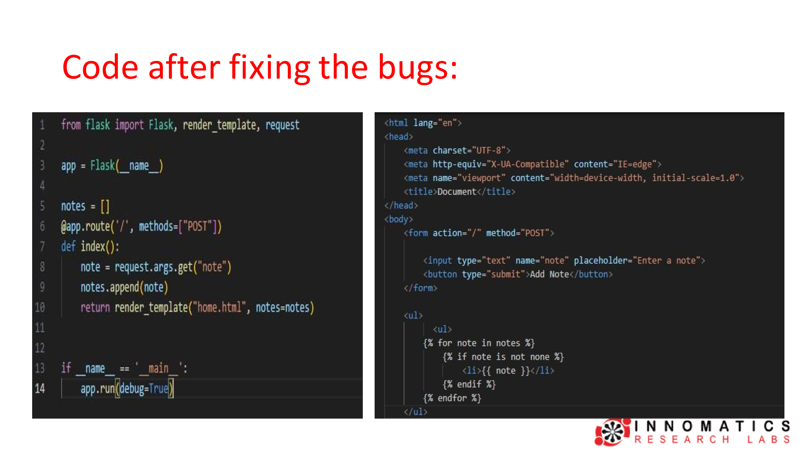

Slide 5

THANK YOU

